Slide 1
Song analysis project
Using power bi
Presented by: SARA NARGIS

Slide 2
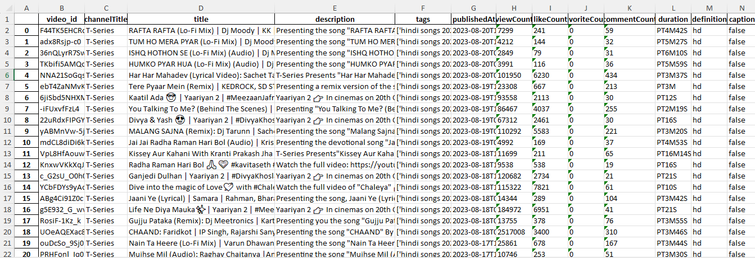
Dataset for song analysis

Slide 3
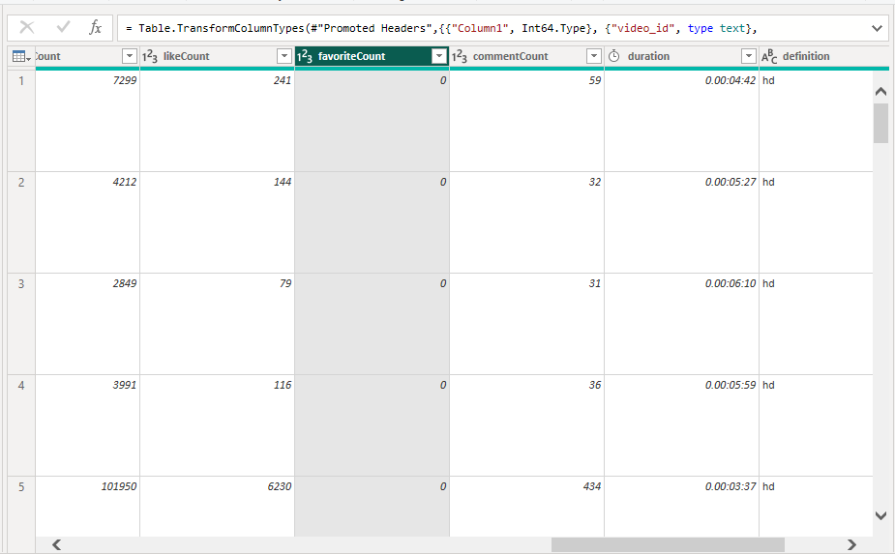
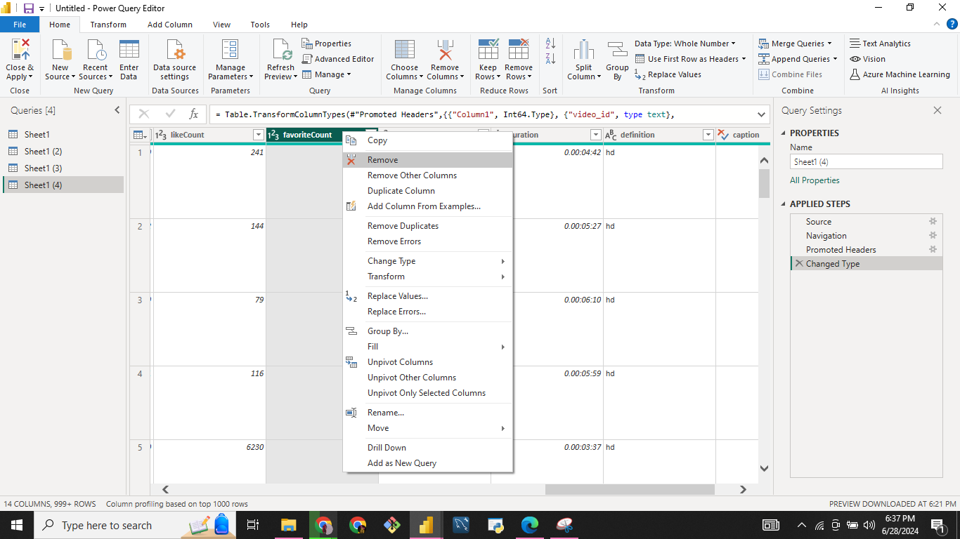
Data analysis
Data Cleaning
Removing columns

Slide 4
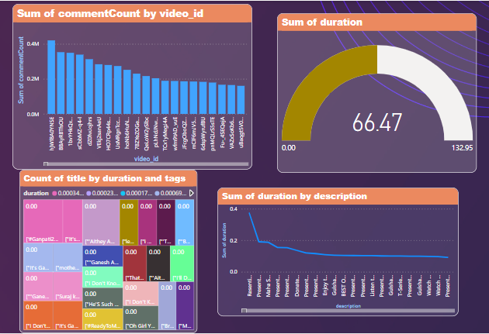
Exploratory data analysis

Slide 5
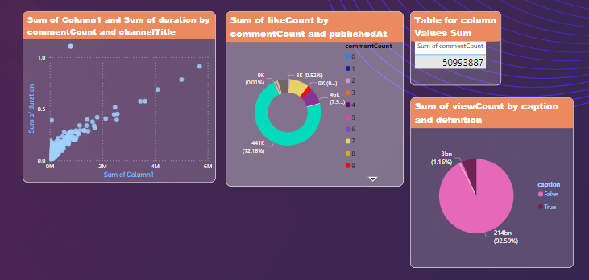
Data visualization as Charts & graphs

Slide 6
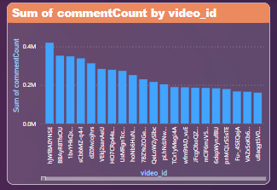
Bar graph
A graph that presents categorical data with rectangular bars with heights or lengths proportional to the values that they represent.

Slide 7
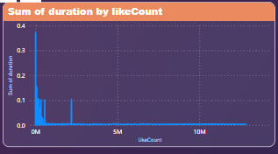
Line graph
A graph that uses lines to connect individual data points.

Slide 8
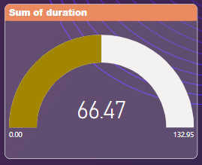
gauge graph
A data visualization type used to display a single value of data in a quantitative way.

Slide 9
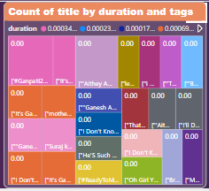
tree map graph
Visualizes hierarchical data in the form of nested rectangles.

Slide 10
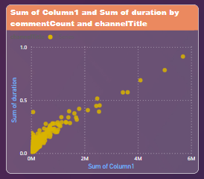
Scatterplot
Scatter plots are the graphs that present the relationship between two variables in a data-set.

Slide 11
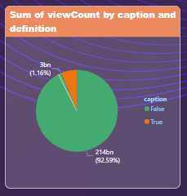
Pie chart
A pie chart is a type of graph representing data in a circular form, with each slice of the circle representing a fraction or proportionate part of the whole.

Slide 12
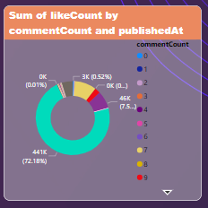
Donut chart
A Donut Chart is a variation of a Pie Chart but with a space in the center.

Slide 13
recommendations
To enhance the performance of your YouTube videos, collaborate with popular artists to draw in more views and engagement.
Optimize your titles and descriptions to be catchy and detailed, which will help capture audience interest effectively.
Maintain a consistent publishing schedule and release content at times that have been identified as optimal for maximum reach.

Slide 14
conclusion
The exploratory data analysis (EDA) of the YouTube video dataset reveals several key insights that can drive strategic decisions to enhance video performance.
Popular videos often feature well-known artists and have engaging, descriptive titles and detailed descriptions.

Slide 15


